Slide 1

“IT Spark Corporation – a Career Services Enterprise”
Submitted in fulfillment of the award of the degree of
Bachelor of technology
in
Information Technology
Submitted By:
Hargovind Singh (0831323108/IT2/2008)
Harjot Kaur (0841323108/IT2/2008)
Harpreet Kaur (1331323108/IT/2008)
Daler Kaur (0871323108/IT/2008)
Inderpreet Kaur (0721323108/IT/2008)
Department of Information Technology
Guru Tegh Bahadur Institute of Technology
Guru Gobind Singh Indraprastha University
Dwarka, New Delhi
Year 2011-2012

Slide 2

“ Future is built by those who can see what’s not yet there …”

Slide 3

Agenda
Introduction
Project Development Workflow?
Technical aspects considered..
Modules segregation
Specifications
Application deployment essentials ..
What are design patterns?
Steps to set up Server and use your Web-app
Screen shots

Slide 4
Part I
INTRODUCTION

Slide 5

OBJECTIVE: our main motive
This project is aimed at developing a web-based PORTAL, a central recruitment Process system for the HR Group of a company. A single point solution to Unemployed graduates & Recruiters .
Some features of this system will be creating vacancies, storing application data, and Interview process initiation, Scheduling interviews, storing Interview results for the applicant and finally Hiring of the applicant. Reports may be required to be generated for the use of the HR group.

Slide 6

TECHNOLOGIES USED
FRONT END using:
Java Server pages (J2EE)
HTML & CSS
Java script
BACK END using:
a) Oracle 10g
DEPLOYMENT/APPLICATION SERVER:
a) Oracle Web-Logic Application Server Enterprise Edition 10.x
QA(quality assurance) SERVER:
a) JBoss Application Server 6.0
Development Platforms:
a) My Eclipse Enterprise Workbench 8.x
Designing Platform:
a) Adobe Dreamweaver CS5.5

Slide 7
Part II
Project Development Workflow

Slide 8


Project Implementation involves :
DATABASE ADMINISTRATION
APPLICATION SERVER CONFIGURATION
CREATING LOCAL DOMAIN ( on which application will be hosted)
SETTING UP NETWORK – configuring router ( which will allow clients to access the application’s services)
CODING OF BUSINESS LOGIC
FRONT-END DEVELOPMENT
TESTING OF APPLICATION IN VARIOUS DEVELOPMENT PHASES’ INTERVALS

Slide 9

Project Development Team
Code Developer : Hargovind Singh
DBA & Application Server Admin : Harjot Kaur
Network Analyst : Inderpreet Kaur
Front-end Designer : Harpreet Kaur
Application Tester : Daler Kaur
In this way the project’s division of work has been done…
Notes:
Project work segregation (division of work):
Harjot: DB admin / Applcn server admin; responsible for writing & providing optimized queries as per their performance, prepares database & administers it, configures application server, prepares local domain & hosts the application(installing the application on server).
Inderpreet: Network Analyst; prepares client – server network proposed soln. (own topology), configures wireless router & establishes working network, manages network, checks secure data transfer( that if client connects successfully after entering the correct security key).
Daler: Web-app tester; tests the application modules being developed (unit testing- on small & independent modules, integration testing- clubbing together the modules , system testing- on fully developed apps.), tests their workability, resistance of the code to increased no. of users(load testing), tries to break the application by entering invalid & random data (monkey testing).
Harpreet: designer; creates beautiful front-end layouts & designs that are dynamic and appealing, arranges the content and manages how data coming from database side is to be resembled, adds an x-factor to the web-app like surround sounds and unexpected but good way of presenting the data to the clients.
Hargovind: code developer; writes the code of the application, main business logic;
Workflow: coder takes designs from designer, queries from the dba, put it in the right place within the code, deploys locally & compiles the code, forwards the app(.war) to tester. Tester tests the application through his various testing methods & reports bugs(if any) to coder, by testing on a QA(quality assurance) server. Thereafter the final code is deployed by server admin, network analyst makes the network and makes the data of web-app available to the client.

Slide 10

Project work segregation (division of work):
Harjot: DB admin & Application Server admin; responsible for writing & providing optimized queries as per their performance, prepares database & administers it, configures application server, prepares local domain & hosts the application(installing the application on server).
Inderpreet: Network Analyst; prepares client – server network proposed soln. (own topology), configures wireless router & establishes working network, manages network, checks secure data transfer( that if client connects successfully after entering the correct security key).
Daler: Web-app tester; tests the application modules being developed (unit testing- on small & independent modules, integration testing- clubbing together the modules , system testing- on fully developed apps.), tests their workability, resistance of the code to increased no. of users(load testing), tries to break the application by entering invalid & random data (monkey testing).
Harpreet: Designer; creates beautiful front-end layouts & designs that are dynamic and appealing, arranges the content and manages how data coming from database side is to be resembled, adds an x-factor to the web-app like surround sounds and unexpected but good way of presenting the data to the clients.
Hargovind: Code developer; writes the code of the application, main business logic.
Main Workflow: Coder takes designs from designer, queries from the dba, put it in the right place within the code, deploys locally & compiles the code, forwards the web-app(.war) to tester. Tester tests the application through his various testing methods & reports bugs(if any) to coder, by testing on a QA(quality assurance) server. Thereafter the final code is deployed by server admin, network analyst makes the network and makes the data of web-app available to the client.

Slide 11
Part III
Technical aspects considered

Slide 12

The main thing around which our project has been build-ed:
A web-application
A career services company that provides Recruitment services to job-seekers & recruiters, with the help of this application .
Our business logic has been written into java or more specifically J2EE.
Through java we can make 2 type of applications:
a) Standalone
b) Web-app
Ours is a web-app (and not a website)
J2EE provides a way to code applications for business growth purposes. Helps in making our localised business logic globalised.

Slide 13

Architecture of J2EE
Java 2 platform Enterprise Edition provides a standard for developing multi-tier enterprise
services. The economy and technology of today have intensified the need for faster ,more
efficient and larger scale information management solutions.
The J2EE specifications satisfies these challenges by providing a standard solution, speed
programming model that improves development productivity, standardization (standardizes)
the platform for hosting enterprise edition and ensures portability of developed applications
with an extensive test suite.
J2EE architecture supports component based development of multi-tier enterprise applications.
A J2EE application system typically supports the following tiers:
1. Client Tier
In the client tier ,web component ,such as servlets and JSP(Java Server Pages) or stand alone
java applications provide a dynamic interface to the middle-tier.
2. Middle Tier
The server tier, or the middle=tier, enterprise beans and web services encapsulates reusable
distributable business logic for the application. These server tier components are contained on a
J2EE application server, which provides the platform for these components to perform actions
and store data(s).
3. Enterprise Data Tier
In the data tier, the enterprise data is stored and persisted typically in a relational database
environment.

Slide 14
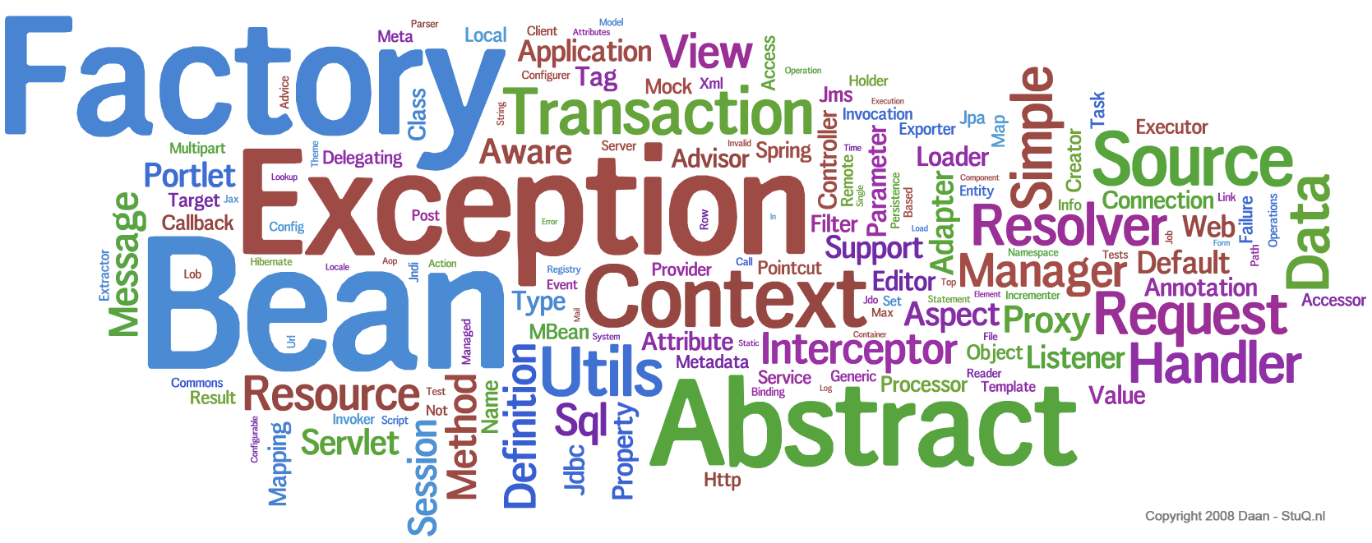
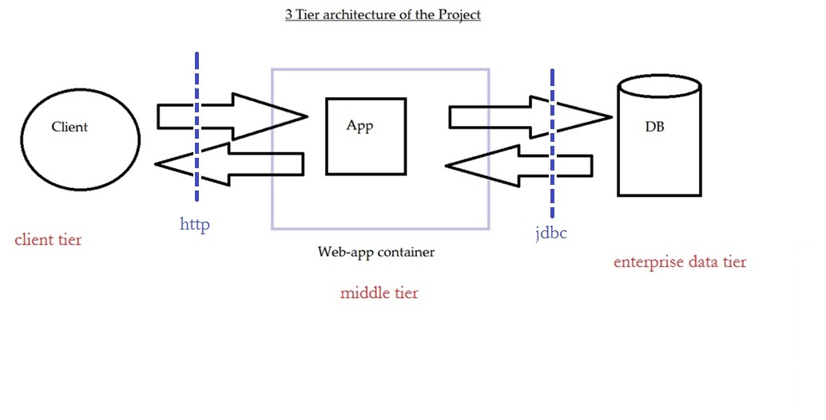
System architecture

Slide 15
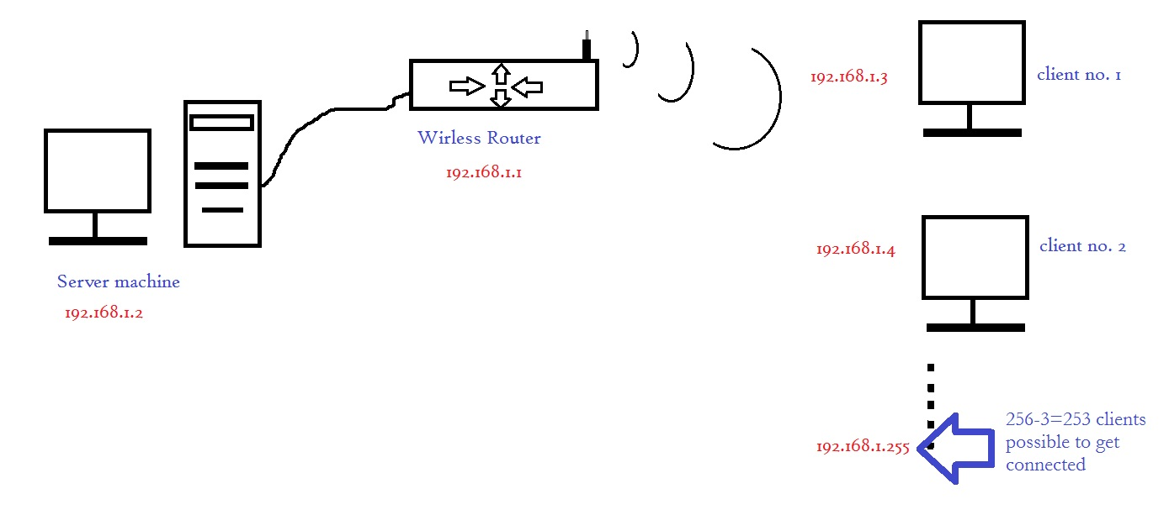
Network Setup

Slide 16
Part IV
Main modules’ segregation

Slide 17

Modules of Project
Administrator
Jobseekers
Company

Slide 18

Description…
Administrator:
Administrator has the full authority over the web-app. He can view all the registered users and have the power to delete them. He can edit the web pages and update them. He can view all the company details also.

Slide 19

Description…
Job Seeker:
A jobseeker can register himself. After registration, he will be directed to his homepage. Here he can update his profile, change password and see the examination details and all.

Slide 20

Description…
Company:
A company can register itself, conduct online examination, approve or disapprove candidates attending examination and provides results about the selected candidates.

Slide 21
Part V
SPECIFICATIONS

Slide 22

SYSTEM SPECIFICATION
Hardware Specification
CPU : PENTIUM IV
PROCESSOR SPEED : 2 GHz
COPROCESSOR : BUILT IN
TOTAL RAM : 2 GB
HARD DISK : 80 GB
KEYBOARD : 105 KEYS
MOUSE : LOGITECH MOUSE
DISPLAY : SGVA COLOR
PRINTER : HP DESK JET
Software Specification
FRONT END : J2EE
BACK END : Oracle 10g
MIDDLE WARE : Weblogic AS 10.3
OPERATING SYSTEM : WINDOWS 7

Slide 23


TABLE SPECIFICATION
Table Name: Login
Fieldname | Data Type | Key
Username | Text | -
Password | Text | -
Status | Text | -
Table Name: Experienced
Fieldname | Data Type | Key
Username | Text | -
ExpYears | Text | -
Company | Text | -
Designation | Text | -
Salary | Text | -
ComAddress | Text | -

Slide 24

Table Name: JobDetails
Fieldname | Data Type | Key
JobId | Text | -
Post | Text | -
Criteria | Text | -
NoOfVacancies | Text | -
Salary | Text | -
LastDate | Text | -
Table Name: Exam
Fieldname | Data Type | Key
JobID | Text | -
Post | Text | -
ExamID | Text | -
ExamName | Text | -
Cutoff | Text | -

Slide 25


Table Name: Question
Fieldname | Data Type | Key
JobID | Text | Primary key
ExamID | Text | -
QuestionNo | Text | -
Question | Text | -
Option1 | Text | -
Option2 | Text | -
Option3 | Text | -
Option4 | Text | -
Answer | Text | -
Table Name: Result
Fieldname | Data Type | Key
StudentID | Text | -
examID | Text | -
JobID | Text | -
mark | Text | -

Slide 26

Table Name: Temp_Data
Fieldname | Data Type | Key
StudentID | Text | -
QstNo | Text | -
Qst | Text | -
Ch1 | Text | -
Ch2 | Text | -
Ch3 | Text | -
Ch4 | Text | -
Ans | Text | -
Table Name: Com
Fieldname | Data Type | Key
CName | Text | Primary key
CAddress | Text | -
CPost | Text | -
CCriteria | Text | -
CUsername | Text | -
CEmail | Text | -
CContact | Text | -
CCutoff | Text | -

Slide 27

Table Name: Details
Fieldname | Data Type | Key
Username | Text | Primary key
Name | Text | -
Gender | Text | -
DateOfBirth | Text | -
CollegeName | Text | -
CollegePhone | Text | -
CollegeEmail | Text | -
Branch | Text | -
Mark | Text | -
Degree | Text | -
Email_id | Text | -
Telephone | Text | -
Address | Text | --
State | Text | -
Pincode | Text | -
Category | Text | -

Slide 28
Part VI
Application deployment essentials..

Slide 29
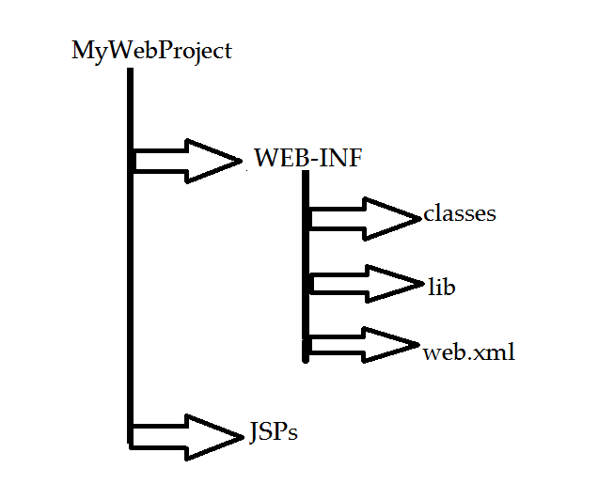

Directory Structure for Deployment

Slide 30
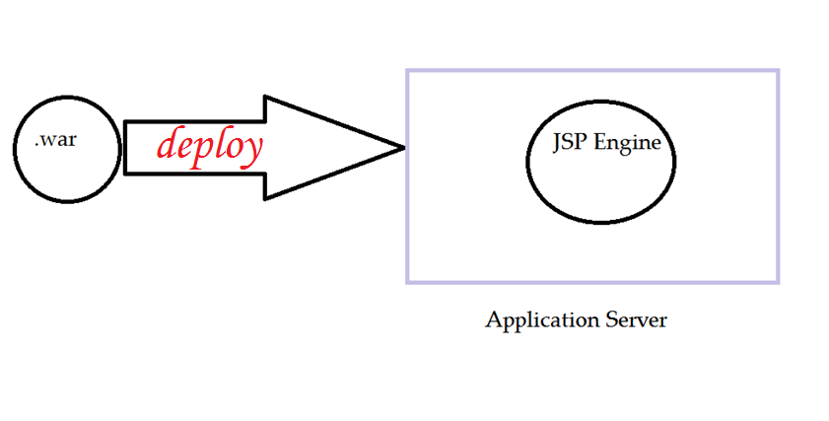
Deploy the bundle of files by creating web archive

Slide 31
The proceeding steps:
The server provides services to your Web-app at the url-pattern given in web.xml
Connect Locally(through port no.) or through remote location(through IP no. of where server is running)
Use your web-app.

Slide 32
Part VII
What are Design Patterns?

Slide 33
Design Patterns
Now, What is a Design Pattern?
“Each pattern describes a problem which occurs over and over again in our environment, and then describes the core of the solution to that problem, in such a way that you can use this solution a million times over, without ever doing it the same way twice.” [1]
[Christopher Alexander]
Design patterns capture the best practices of experienced object-oriented software developers.
Design patterns are solutions to general software development problems.
In a nutshell,
Design patterns are nothing but solution to the recurring problems..

Slide 34

Design Patterns Used in Project
Singleton
Used when we have to make a single object of that specific class.
DAO (Data Access Objects)
When the data that comes from DB is represented at the front-end.. Using object
Decorator
Encapsulating inner objects into high level objects and improving their workability

Slide 36
Part ***
Making the most out of JSPs

Slide 37
Overview of how to make out the best of JSPs
JSP is another way to create dynamic web - pages.
JAVA Server pages ALREADY are
# DYNAMIC
# SUPPORTS CLOUD PROGRAMMING ( ELASTICITY OF WEB-APP)
# PROMOTES PORTABILITY
# MAKES YOUR WEB-APP GLOBALISED
# ROBUST
# SUPPORTS DISTRIBUTED ENVIRONMENT PROGRAMMING
MOREOVER WRITTEN IN JAVA !! THEREFORE THEY ARE REUSABLE COMPONENTS AND CAN BE EASILY USED ANYWHERE ....

Slide 38

Life-Cycle Of JSP
Phase 1 JSP Page translation
Phase 2 Compile The Generated Servlet
Phase 3 Load the Servlet class
Phase 4 Instantiate the loaded Servlet
Phase 5 Call the JSP init() method
Phase 6 Call the _JSPservice() method
Phase 7 Call the JSP destory() method

Slide 39
TAGS IN JSPS
JSPs being a tagged based language has main 9 tags:
1) <!-- --> COMMENT
2) <% %> SCRIPLET ( we put here pure java that
will go in the servlet's service() method)
3) <%! %> DECLARATIVE
4) <%= %> EXPRESSION ( Everything written here goes into SOP( here ) ; used for printing )
5) CUSTOM tags
6) JSTL Tags
7) ${ } Expression Language
8) ACTION tags
9) JSP Directives

Slide 40
ACTION TAGS
< jsp : include page= “” >
< jsp: forward >
< jsp: param >
< jsp : usebean id=“” class = “”>
< jsp : setProperty >
< jsp : getProperty >
7) < jsp : plugin >
DECLARATIVE TAGS
1) < %@ tag lib =“” %>
2) < %@ page import =“” %>
3) < %@ include file =“” %>

Slide 41
How to code it so that it works as we want??
Generally, we embed java code in html pages ( extension already changed to .jsp) and then make a web-archive of that directory (in specific format as discussed earlier) an deploy that web-app in application server, which will compile the code and load it into memory… successfully installed web-app is hosted and can now service the connected users.
The JSP code is written in way that a server can understand your program flow….
The main file from where the application must have to launch….
index.jsp / index.html
As per the welcome file list mentioned in web.xml, the launch point of web-app is made available… we code it as (in web.xml) …
<web-app>
<welcome-file-list> index.jsp </welcome-file-list>
</web-app>
->your web-app will now launch from index.jsp

Slide 42
The flow of control part >>> from one page to another .. Thereby querying the DB at backend…..

Slide 43
Part VIII
Basic Steps Involved to set up server configurations and use your Web-app

Slide 44
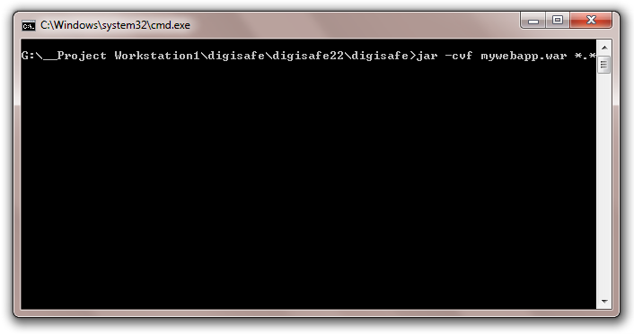
STEP 1:
CREATE THE WEB APPLICATION ARCHIVE -> WAR FILE
G:>\__Project Workstation1\digisafe\digisafe22\digisafe>jar -cvf mywebapp.war *.*
Here “jar” is a utility , already installed when you install Java
Meaning of commands:
C – create
V – verbose (to show)
F – file
*.* - means all in folder & sub-folders

Slide 45
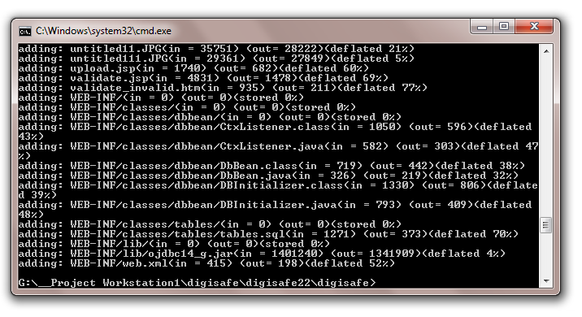
War File (web – archive, your web-app) successfully prepared …

Slide 46
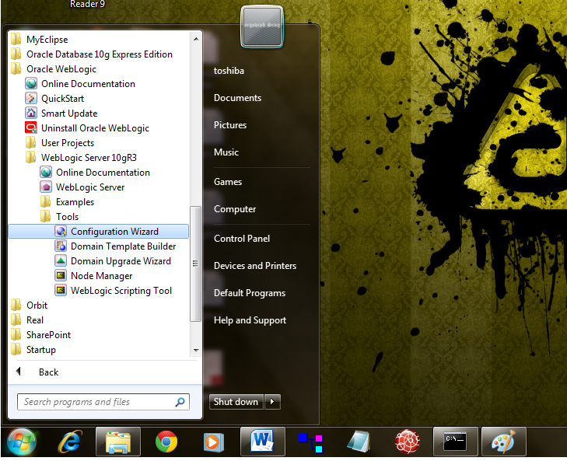
STEP 2:
AFTER INSTALLING ORACLE WEBLOGIC SERVER 10.X, START THE COFIGURATION WIZARD

Slide 47
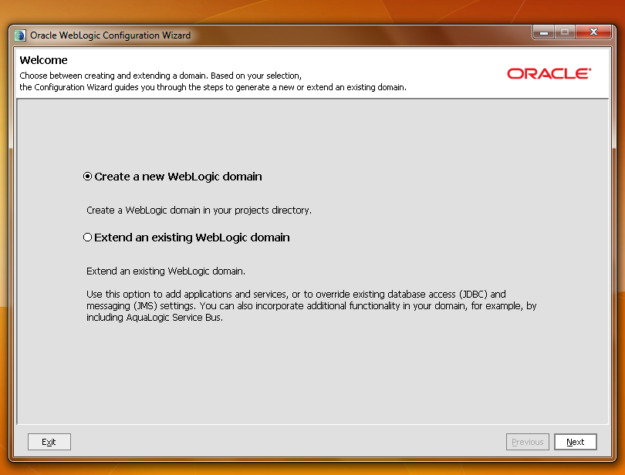
STEP 3:
CREATE A CUSTOM DOMAIN

Slide 48
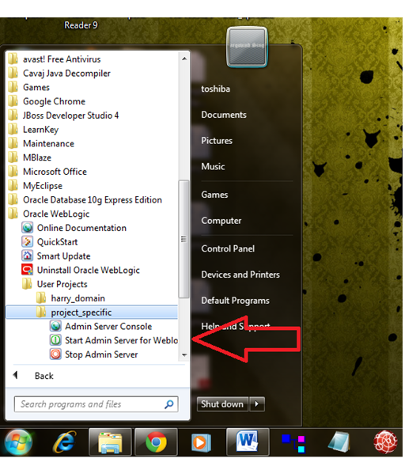
STEP 4:
START YOUR CUSTOM WEBLOGIC DOMAIN SERVER

Slide 49
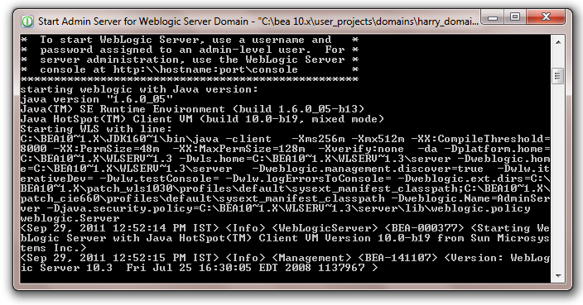
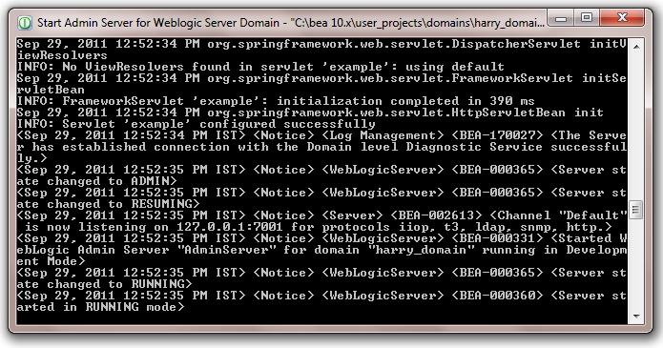
SERVER’S SERVICES GETTING STARTED …

Slide 50
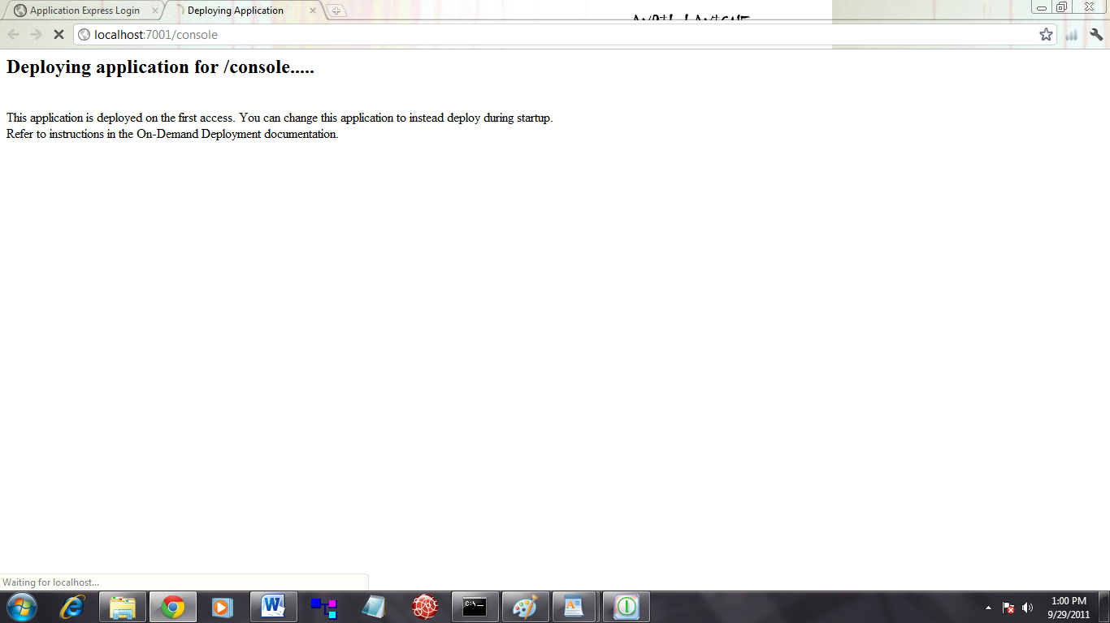
STEP 5:
GO TO YOUR LOCAL SEVER’S CONSOLE

Slide 51
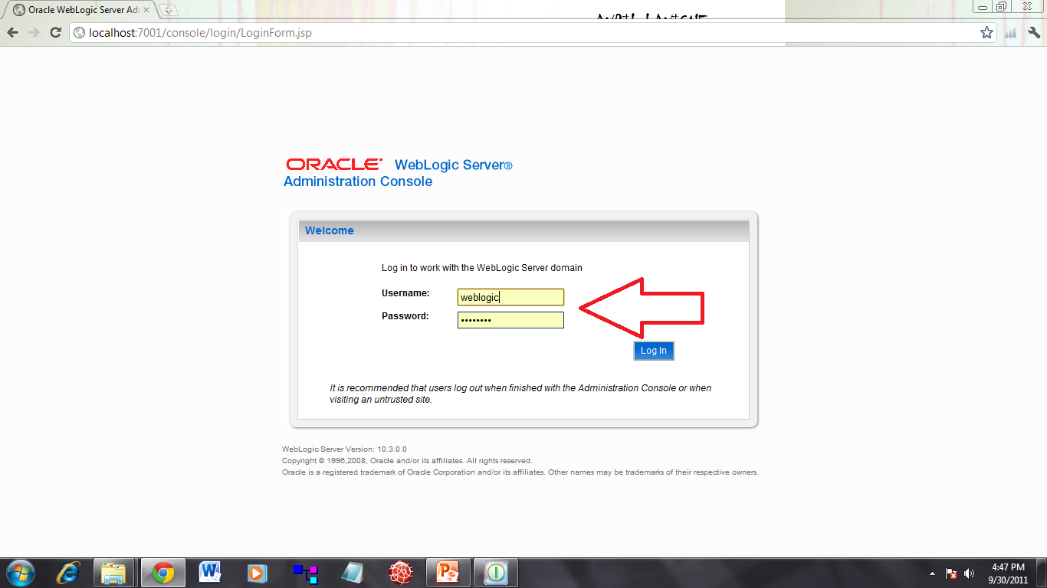
STEP 6:
ENTER THE CREDENTIALS YOU FILLED IN WHILE CRATING YOUR CUSTOM DOMAIN

Slide 52
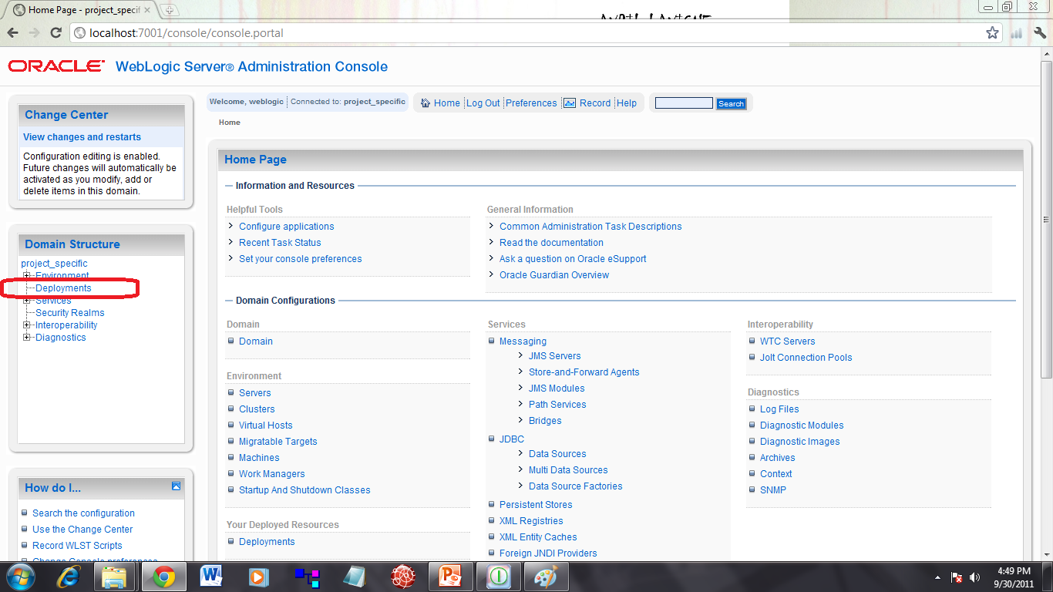
STEP 7:
LOGIN INTO DEPLOYMENTS SECTION

Slide 53
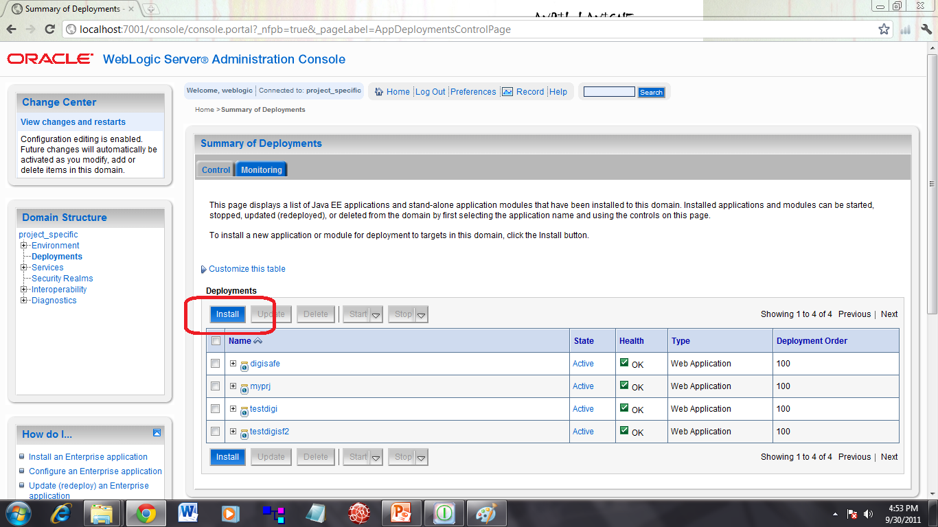
STEP 8:
TO DEPLOY YOUR WEB-APP, GO TO INSTALL

Slide 54
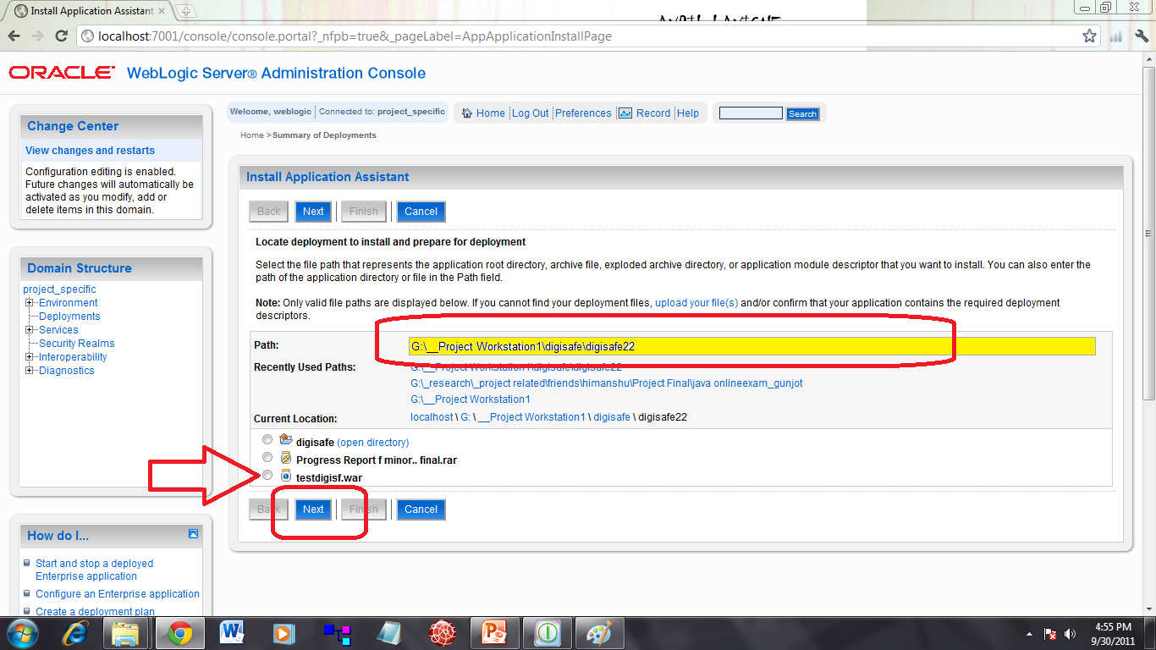
STEP 9:
a) GIVE THE DIRECTORY PATH
b) SELECT YOUR WEB-APP

Slide 55
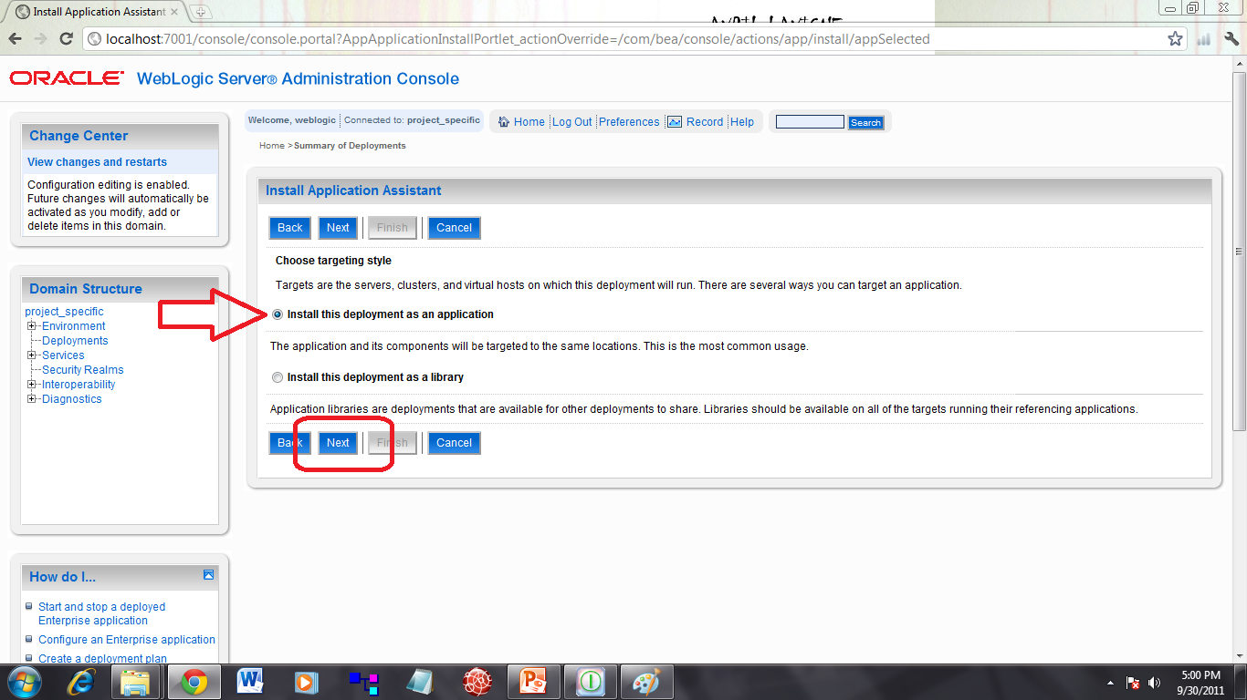
STEP 10:
INSTALL/DEPLOY YOUR WEB-APP AS AN APPLICATION

Slide 56
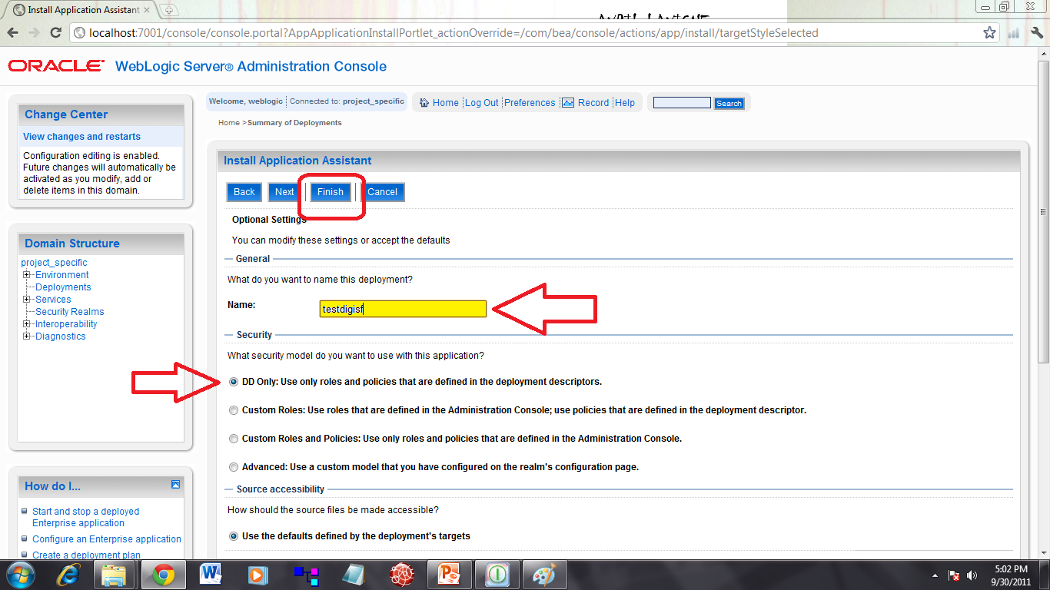
STEP 11:
CHANGE THE DEPLOYMENT FILE NAME IF NEEDED, ELSE LET IT BE AS IT IS.
FINISH THE INSTALLATION
GO TO DEPLOTMENTS’ CONFIGURATION SCREEN

Slide 57
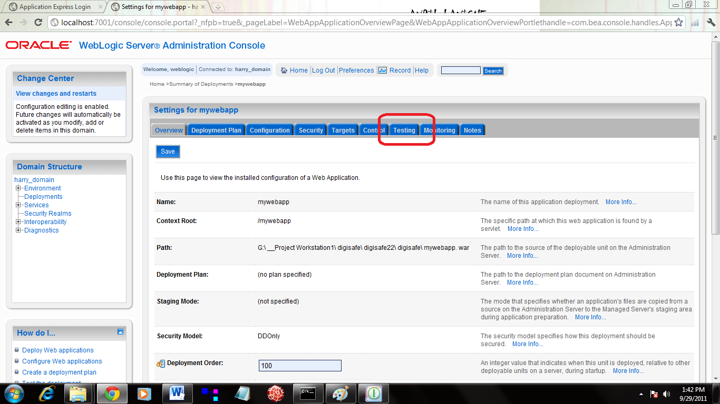
STEP 12:
GO TO TESTING SECTION OF THE WEB-APP CONFIGURATION SCREEN

Slide 58
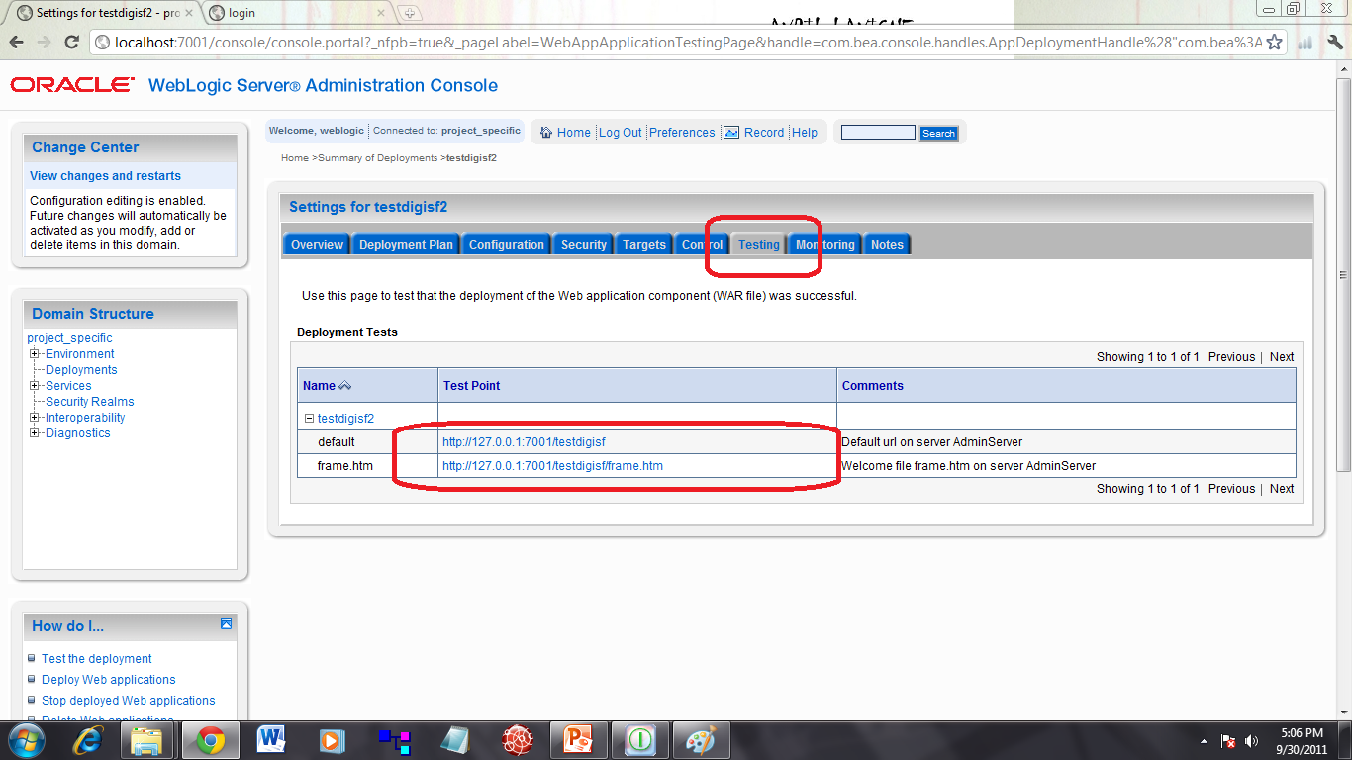
STEP 13:
DEPLOYMENT IS SUCCESSFULL
NOW, CLICK THE URL-PATTERN YOU SETTED TO LAUNCH YOUR APP

Slide 59
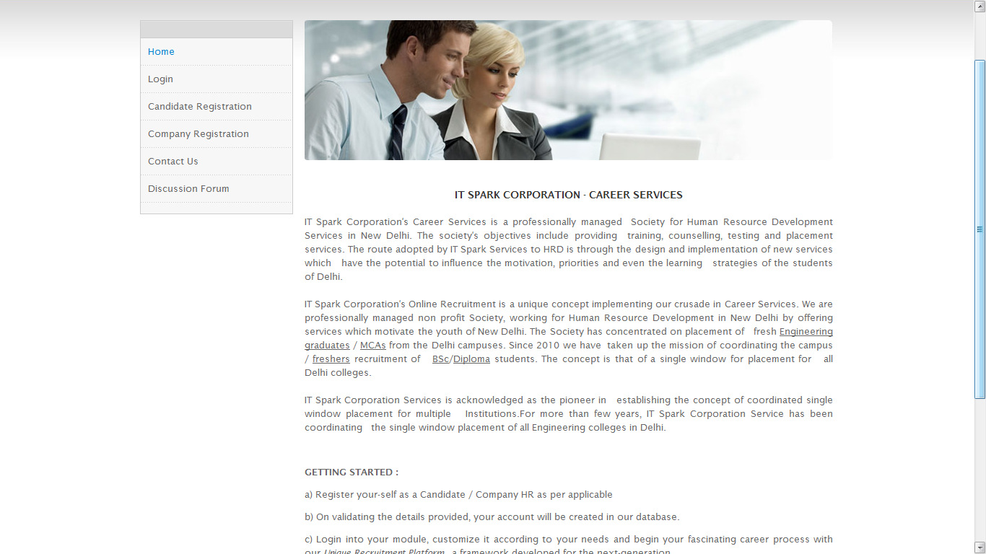
STEP 14:
YOUR WEB-APP HAS NOW LAUNCHED…

Slide 60
Part IX
Screen shots

Slide 61
Main Home page

Slide 62
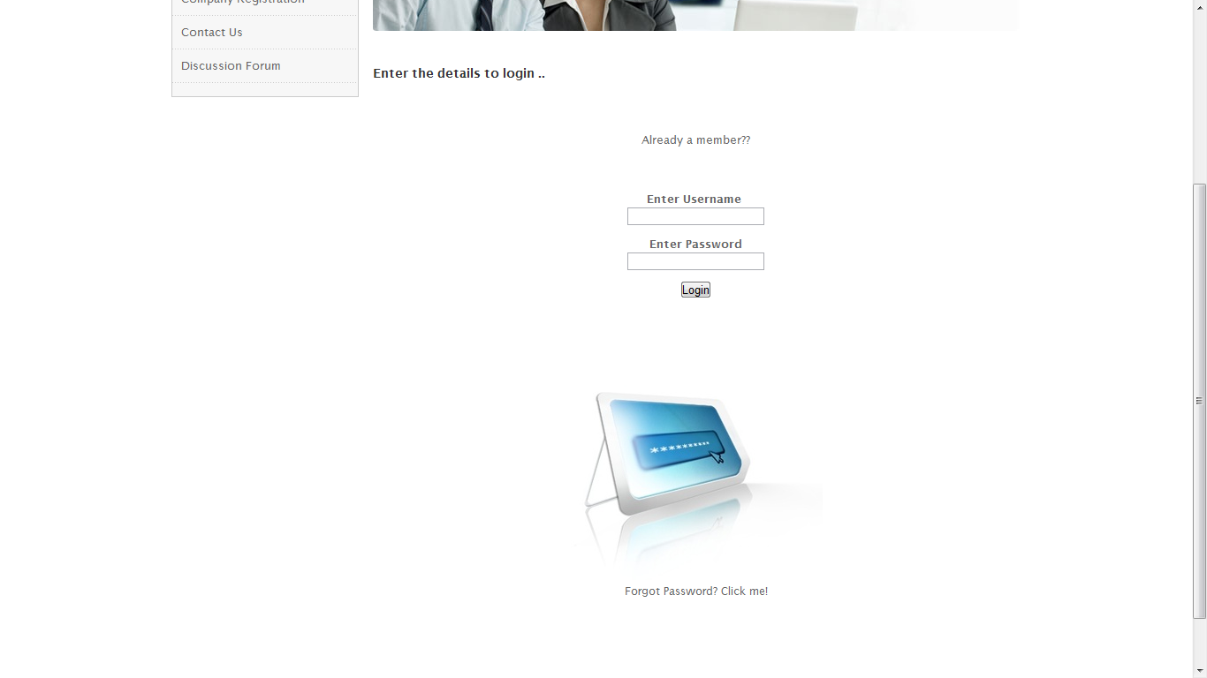
Login Page

Slide 63
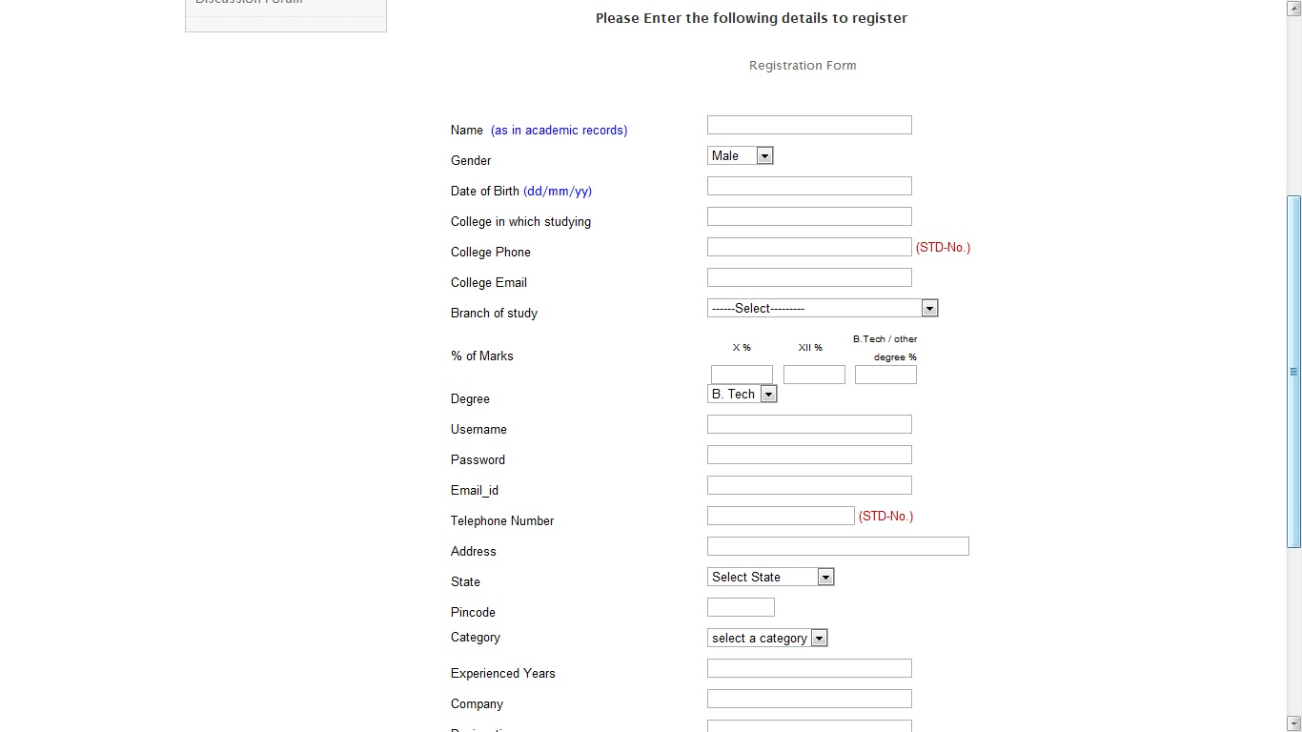
Candidate Registration Page

Slide 64
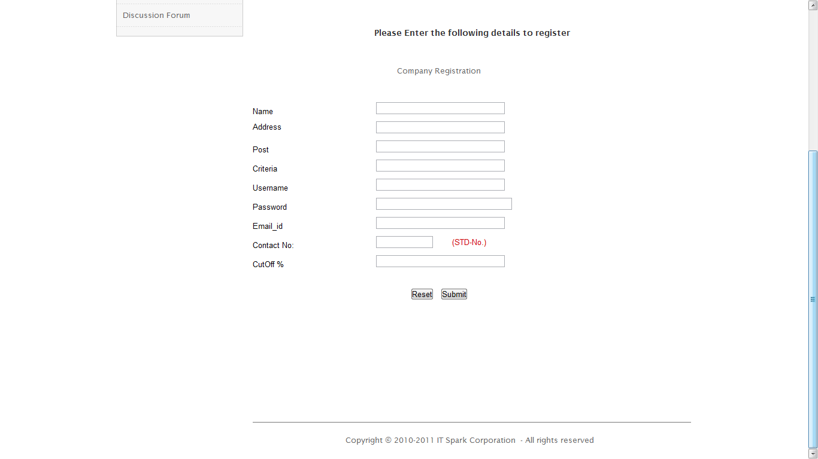
Company Registration Page

Slide 65
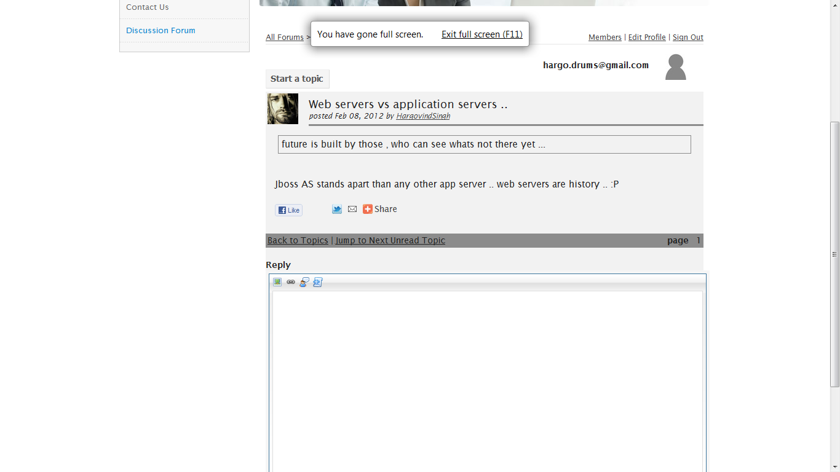
Discussion Forum Page

Slide 66
Part X
Application enhancement features
=> Under development

Slide 67
LIST OF NEW REQUIREMENTS IN THE MAJOR PROJECT
(1) Add a Download/goodies section .. comes in MAIN-HOME of app
Must have the >> interview related manuals , Important Links, Video section,
(2) Login into a special goodies section through FACEBOOK/TWITTER/LINKEDLN ..
(3) QUERY SECTION.. sends mail to the admin gmail .. (JAVA MAIL API) and the admin will revert back to the query making person's e-mail address.. (true e-mail)
Now we can revert back to the user by his specified mail ID
(4) MAKE a page in FACEBOOK reffering to IT SPARK CORPORATION ..
having the details of all people involved in the project….this page will be redirected through Contact-Us page in MainHome ..
(5) A blog, forum , videos, links for exam prepration ... A candidates' GOODIES/DOWNLOAD section
(6) Change normal exams >> to Certification level interview exams
(7) Make a mock test...
(8) Add a special intro page before exam showing "POWERED BY JAVA"
(9) Loose-couple the DB coding .. Make it available for migration.. Implement ORM through >> Hibernate

Slide 68

Presented By :
Hargovind Singh Inderpreet Kaur
Harjot Kaur Daler Kaur
Harpreet Kaur
Thank You

